Slide 1


Presented by Meenakshi
CUSTOMER BEHAVIOUR ANALYSIS
Understanding Consumer Trends for Improved Marketing Strategies of
SHOP EASY

Slide 2
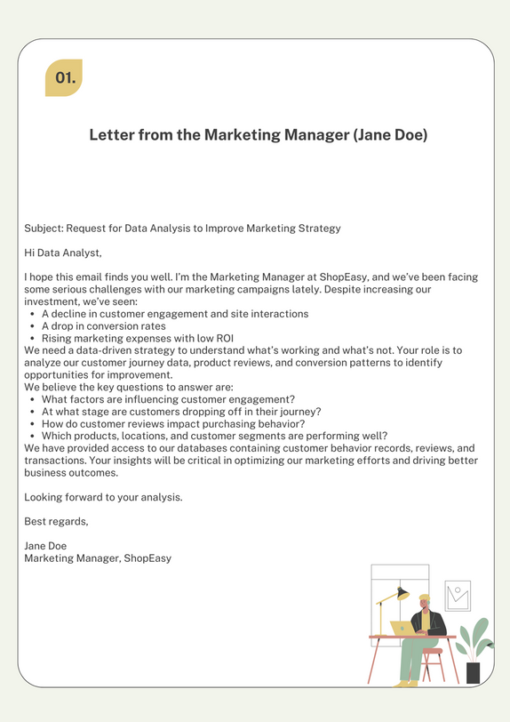
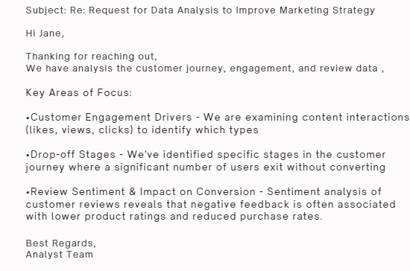
Letter to Marketing MANGAER

Slide 3
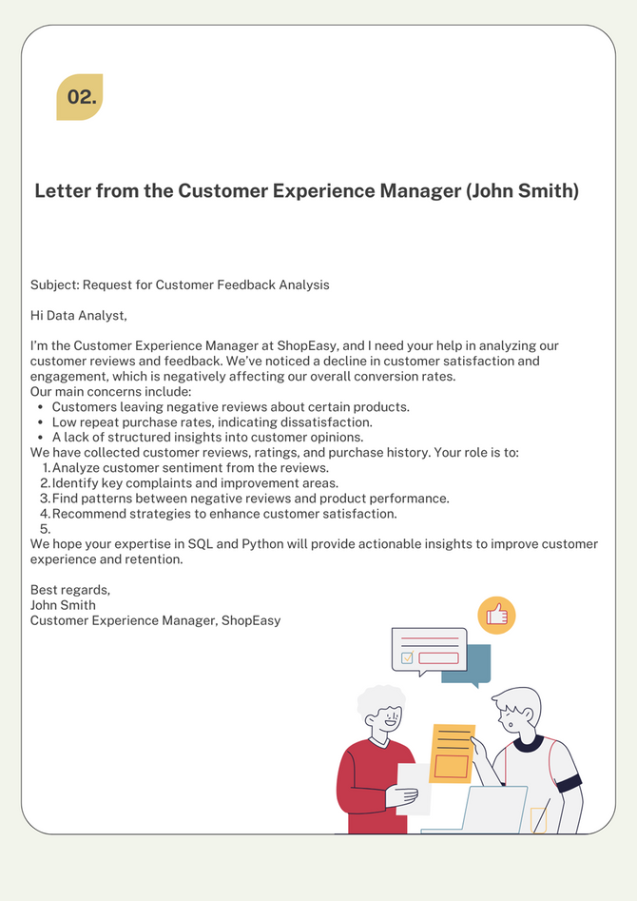
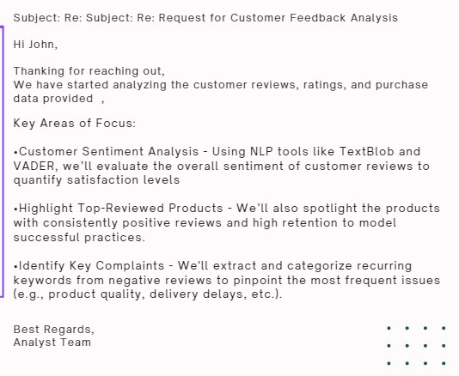
Letter to Customer Experience Manager

Slide 4




Agenda(Table of Contents):
•Introduction
•Objectives
•Technologies Used
•Data Sources and Description
•Data Preparation(SQL & Python)
•Main Challenges Identified
•Insights & Recommendations
•Conclusion

Slide 5

Introduction to results analysis
•Customer Behavior Analysis helps companies understand how customers interact with products and services.
•This analysis involves extracting key insights from data to guide marketing and sales strategies.
•The goal is to identify patterns that lead to customer retention, drop-off, engagement, and satisfaction.

Slide 6

Objectives:
•Identify key customer behavior trends such as product preferences, buying patterns, and engagement duration.
•Understand factors affecting customer retention and drop-off.
•Analyze customer reviews to gauge product satisfaction and areas of improvement.
•Assess marketing effectiveness by measuring customer acquisition, retention, and conversion rates.

Slide 7


Technologies Used:
Python: Data analysis and report generation.
MySQL: Database management and data extraction.
Pandas: Data manipulation and transformation.
NLTK: Basic sentiment analysis from customer reviews.
MYSQL Connector: Connecting Python with MYSQL to run queries.

Slide 8
Data Sources and Description:
Data Overview:
•Customers Data: Contains customer demographics, ID, etc.
•Products Data: Contains product details.
•Engagement Data: Data about customer interactions.
•Customer Journey: Data on customer progress through stages (e.g., product discovery to purchase).
•Reviews Data: Customer reviews and ratings.
Data Sources:
•CSV files, MySQL database (e.g., using SQL queries and Python).

Slide 9
Data Preparation (SQL & Python):
•Data Extraction:
•SQL queries were used to retrieve relevant customer and product data.
•Example: Using JOIN to combine customer data with product engagement.
•Data Transformation:
•Data cleaning: Removed null values, duplicates.
•Created new features: Derived metrics such as average engagement time per customer, ratings.
•Used Python libraries (e.g., Pandas) to manipulate and analyze data.

Slide 10
Main challenges identified
01.
02.
03.
Customer Journey Analysis:
Drop-Off Points
Successful Conversions
Average Durations
Customer Review Analysis:
Highest & Lowest rated products
Sentiment Analysis of Customers
Review Trends
Marketing Effectiveness:
Customer Retention Rate
Repeat vs First time Buyers
Best Performing Products

Slide 11
Insights & Recommendations:
Customer Who read reviews are more likely to Purchase.
Region specific product preferences indicate a need for localized Marketing.
Actionable Recommendations:
Improve product descriptions and review visibility to boost conversion rates.
Target marketing campaigns toward repeat buyers in high performing regions.
Focus on resolving common complaints in low-rated products.

Slide 12

Conclusion
01.
02.
Summary:
Customer Behaviour Analysis provided a deeper a deeper understanding of buying Patterns, Sentiment and engagement.
Marketing Strategies can now be tailored to improve Customer retention and Satisfication.
Future Scope:
Future analysis of seasonal trends or specific customer segments.
Explore advanced techniques like Machine Learning for predictive analytics.

Slide 13

Presented by Meenakshi
THANK YOU
SO MUCH!

